Slide 1
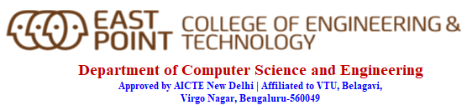
Internship Seminar(18CS185)
Presented By, Under The Guidance of,
MANOJ BABU G R USN:1EP18CS054
8th SEM ‘A’ SEC
Year:2021-2022
Prof. Manimegali
Assitant Professor
Dept. of CSE ,EPCT

Slide 2

ABOUT THE COMPANY
Rapid Circle supports organizations in their Digital Transformation journey through digital workplace and collaboration platforms based on Microsoft cloud technologies such as Office 365, Azure, Dynamics 365, Windows 10 and Xamarin.
They offer continuous guidance from strategy to support, and from technical to organizational change. Always with mobile and Cloud as basic principle.
Since 2008, Rapid Circle has been supporting organisations with the innovation of collaboration and the digital workplace, with the transition to the cloud and with the improvement of service with Office 365, Microsoft Azure and CRM online. Mobile and Cloud are our guiding principles.
They do this with 200 employees in Amsterdam (The Netherlands), Pune (India) and Melbourne (Australia).

Slide 3

Client

Slide 4
INTRODUCTION TO THE DOMAIN OF INTERNSHIP
Data Governance, Engineering and Data Management Tooling:
Data Management of Data across different environments and in an organisational level. Stewardship on the data to manage Regulatory and compliance issues.
Data Engineering is a context to move around the data in an organisation for various purposes such as Data Analysis, Software applications etc.
Data Governance is to mainatin data to reflect better data driven business function.

Slide 5



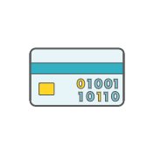

WHAT IS COLLIBRA?
Collibra is our strategic enterprise-wide data catalog & data governance solution: a one-stop-shop for finding data. It aims to increase data awareness, whilst reducing the time spent searching for data.
Value from Data will be realised by providing information on:
1
2
3
4
5
WHICH
WHERE
WHO
WHAT
HOW
data is available?
Is the required data ?
Is the Business data owner?
do we need the data for?
do I gain access to the data?
DATA
GOVERNANCE
CONTEXT & IMPACT ANALYSIS
CATALOGUE
LINEAGE
ACCESS
Collibra is a market standard, fully functional data catalogue & data governancve solution with extensive support & training materials
S

Slide 6
WHY COLLIBRA?
BUSINESS USERS
DATA GOVERNANCE USERS
TECHNICAL USERS
ANALYST, MANAGER, ENGINEER, SCIENTIST, ETC.
DATA SCIENTIST, ARCHITECT, DIY USER, ETC.
DDO, DVO, ETC.
‘I want to discover the trusted, high quality data I need and quickly obtain to access’
“I want to know the data I steward for the business and its dependencies and to set standards;
“I know where to look, and I want to explore the technical metadata structures to meet my aims’
Goals
Quickly discover trusted data without using techy terms or having to ask a professional
Understand what I can and can’t do with the data I discover
Know on which systems the data resides
See who is the custodian of the data
Request access at a click of a button
Goals
I want to know the data I steward on Shell’s behalf
I would like to manage data definitions, rules & policies via single platform
I would like to automate data governance using internal workflows
Manage and approve Data Access Requests
Goals
Able to discover, trust and understand data available in multiple platforms & applications
Single place to check data lineage & transformation logics
An automated approval process to access the data
Quick and reliable impact analysis when I propose changes to the data landscape

Slide 7

WHY DO I NEED COLLIBRA?
CATALOGUE
FIND
‘DISCOVER’ NOT ‘SEARCH’
DATA DICTIONARY
Wouldn’t it be great if I could have a ‘Google-like’ discovery tool that preferentially shows me the most trusted and reliable datasets, so I can get to work quickly with confidence and not spend 80% of my time ‘searching’ for data.
REFERENCE DATA
UNDERSTAND
CAPTURE ‘TRIBAL KNOWLEDGE’
BUSINESS GLOSSARY
Wouldn’t be great if I didn’t have to find someone who knows someone who might be able to pull out an Excel sheet to show what data is available to me, if I’m allowed to have it and where I can get access?
STEWARDSHIP
POLICY MANAGER
TRUST
‘REAL’ DATA GOVERNANCE MADE SIMPLE
Wouldn’t it be great if I could easily understand the data I steward on behalf of Shell, which businesses and process use that data, and easily carry out my role through simple workflows?

Slide 8
EVERYTHING IS AN ASSET…
The building blocks of Collibra are called Assets. This essentially represents ‘a thing’.
contains
COLUMN
TABLE
Is part of
…AND ASSETS HAVE RELATIONS & CHARACTERISTICS
Relations describe how two assets associate to each other, and attributes add more description to an asset

Slide 9
INHERITANCE
Occurs when an asset is a subtype of another asset. Subtypes will inherit the existing relations and characteristics.
BUSINESS ASSET
If using subtypes, the inheritance should be reviewed in order that the relations ‘make sense’. Also, if the subtypes are used, the supertypes should be removed from the metamodel else divergent approaches to modelling assets can occur, leading to chaos.
Is subtypes of
BUSINESS DIMENSION
Are subtypes of
DATA CATEGORY
LINE OF BUSINESS
BUSINESS PROCESS
USE CASE

Slide 10
ASSETS ARE GROUPED BY DOMAINS
Domains group assets which have an affinity to one another. For example, all assets below are types of business dimensions
BUSINESS DIMENSIONS (DOMAIN)
DATA CATEGORY
LINE OF BUSINESS
BUSINESS PROCESS
USE CASE

Slide 11
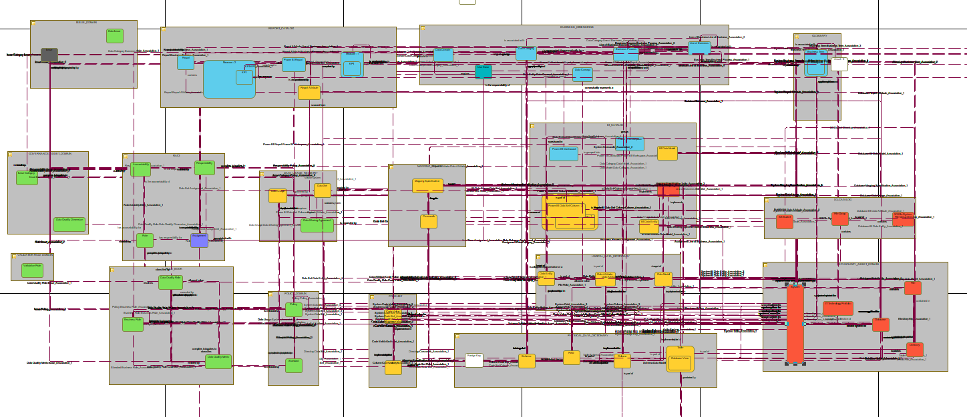
HIGH LEVEL COMPONENTS
Reports
Issues
CONTEXTUAL ELEMENTS
Keystone Elements
Assignment
Use Case
Business Dimensions
Glossary
Roles
Rules (inc. DQ)
RACI
Data Sets
Mapping
Specs
BI Catalog
Technology
Policies
Code
Lists
Logical Metadata (Data Model etc.)
FACTUAL ELEMENTS
Technical (Physical) Metadata

Slide 12
KEYSTONE ELEMENTS BRING IT ALL TOGETHER
Keystone Elements
Governs on behalf of
CONTEXTUAL ELEMENTS
Assignment
governs
Use Case
Business Dimensions
Roles
Becomes an
Form a
RACI
Data Sets
Technology
come together into a
Data
FACTUAL ELEMENTS
Policies

Slide 13


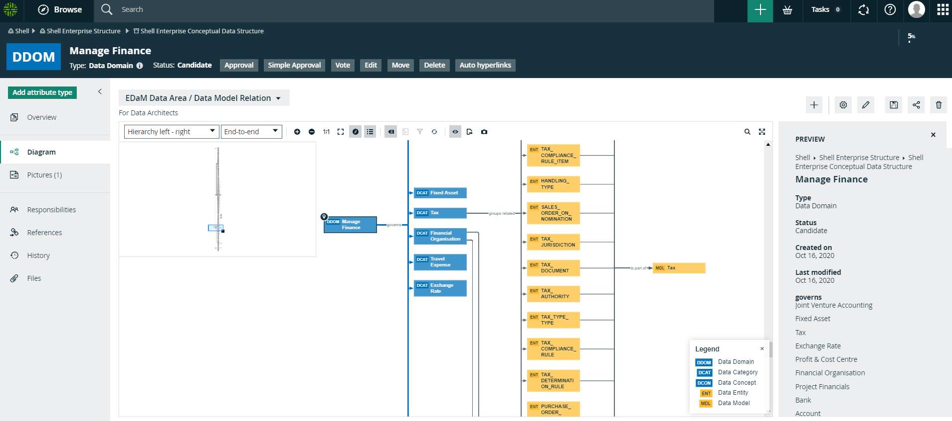
LINEAGE DIAGRAMS HELP TO VISUALISE ASSOCIATIONS
B
DG
Views can be saved or made default for a particular asset class (in this case, Data Domain)
Edit Diagram View Configuration (next slide)
Associations can be visualised
This Diagram shows that a Data Domain contains child Data Categories, which in turn are the parent of Data Concepts and Data Entities. Data Entities [of potentially more than 1 Data Category] are then displayed on an EDaM Data Model

Slide 14
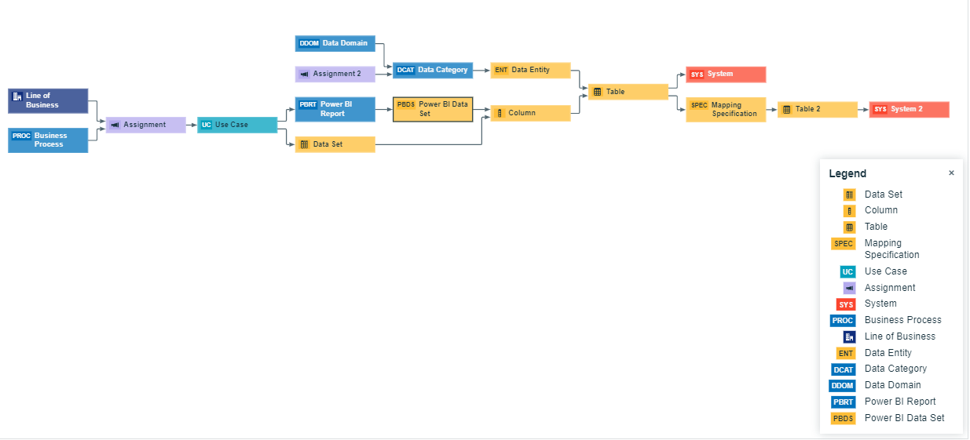
LINEAGE DESIGN IN COLLIBRA: UK MORNING REPORT

Slide 15
COLLIBRA ASSET MODEL AND METAMODEL

Slide 16
ENVIRONMENT STRUCTURE
Zone 1 - testing zone with access to the instances with testing data
Zone 2 - production zone with access to the instances with production data
OM Migration – using the new Migration functionality to migrate Assignments (Asset Types,
Attributes Types, Relation Types etc.) with Roles (Global and Resource), Workflows and
Visualization components (Dashboards, Traceabilities, Search Filters etc.)

Slide 17
TASKS
Workflow Development – test custom workflows to be sure that they will not create/change/remove all existing content
Integration Development e.g. bulk data import tests – check the amount of the data imported, quality of this data and avoid problems with the instance performance that end users can feel during the testing period.
Manual Data Import (from excel) – test data import and results
Data Integration – Using ADF, Azure Functions.
Support design and testing of new use cases before bringing it to Production. Several use cases can be in development at the same time
Design and development of the Traceability diagrams, Dashboards, UI customizations.
After development and first test configuration of the operating model (assignments, roles, workflows and views) will be migrated to Acceptance

Slide 18
CONCLUSION
Worked on Many projects in the initial phase.
Got Adapted to the Corporate environment. Learned to work alongside a team and also manage people’s work when they are not present.
Explored many options on technical end and how to build projects.
Understood how architectures and designs work in a project.
Understood Support and Budget perspective of Enterprise Projects.

Slide 19
Thank You

